Slide 1
Biometric Course Lab Linear Filtering
Kevin Hernández Díaz

Slide 2
Biometric Lab 3: Linear Filtering
Outline:
Linear filters:
What are they?
How are they applied?
Examples and applications
Blurring/Low Pass Filters
Edge Detector/High Pass Filters
Separable Filters
Gaussian filters

Slide 3
Linear Filters: What are they?
Linear filtering is one of the most basic/common yet powerful operations in computer vision
It is the cornerstone on which most application are built
Convolutional Neural Networks, one of the most powerful tool in AI and computer vision are, simply put, a bunch of linear filters. Although together with some other operators to add non-linearity and/or other functionalities

Slide 4

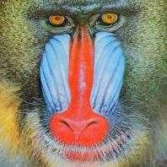

Linear Filters: What are they?
As we learn in lab 1, images are nothing else than matrices
Filters/kernel are just a small matrix that is “convolved” with an image
Mandrill image in Matlab
Sobel filter

Slide 5
Linear filter: How are they applied?
How does filtering works?
Credits: Michael Plotke / CC BY-SA (https://creativecommons.org/licenses/by-sa/3.0)

Slide 6
Linear Filter: How are they applied?
By doing the scalar product between the filter and every subregion of the image you can:
Apply some transformation to the image
Find regions in the image that have a similar structure to the one in the filter

Slide 7
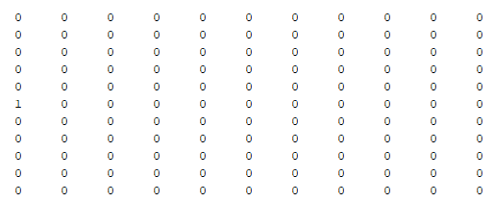
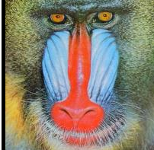
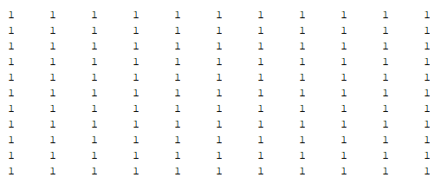

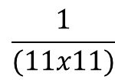
Linear Filter: Examples
Translate an image
Blurring
*
=
$$\frac{1}{(11x11)}$$
*
=

Slide 8
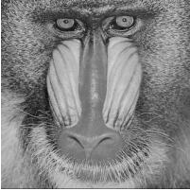
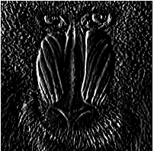




Linear Filter: Examples
Edge detection
sharpening
*
=
*
-
*
=

Slide 9

Linear Filter: Blurring/LP filter
High frequency components are represented as fast/steep changes in pixel values within the images.
Low pass filter removes those fast changes
The bigger the filter size is, the more destructive it is
original
Uniform filter
size 5
Uniform filter
size 11

Slide 10
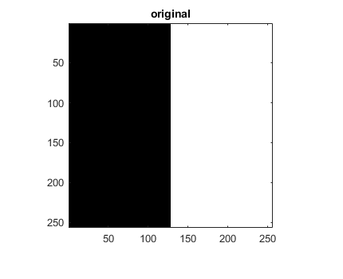
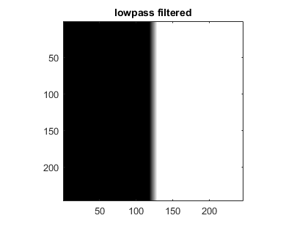
Linear Filter: Blurring/LP filter
Black=0
White=255
Filter=ones(11,11)./121
Black Area
Middle area
White area
Part of the Matrix filled with 0
, part with 255
The results when we do
the scalar product with a
Uniform filter that add to 1
Is some value in the range (0,255)
Matrix of 255 * (uniform matrix that add to 1)
=255
Importance of normalize the filters!
Matrix of Zeros * any number
=0
0 0 0 255 255
0 0 0 255 255
*
0.1 0.1 0.1 0.1 0.1
0.1 0.1 0.1 0.1 0.1
=
102

Slide 11
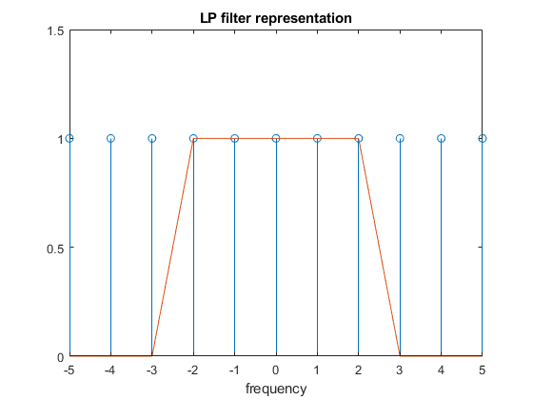
Linear Filter: Blurring/LP filter
View from a frequency perspective
Low Pass Filter for 1D-signals:
Keep only the low
frequency components

Slide 12
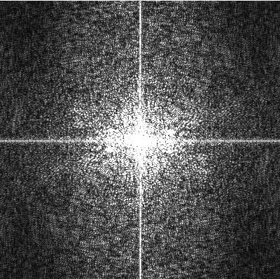
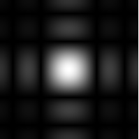
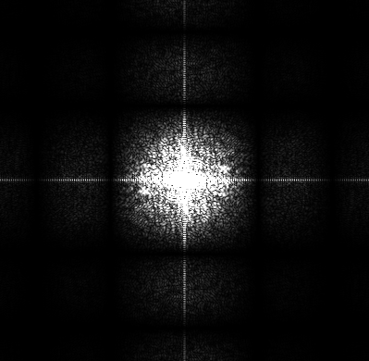

Linear Filter: Blurring/LP filter
From the frequency point of view, we are keeping only the frequencies that falls below a certain frequency
$$\frac{1}{(5x5)}$$
=
*
Original
Uniform filter
size 5
x
=

Slide 13
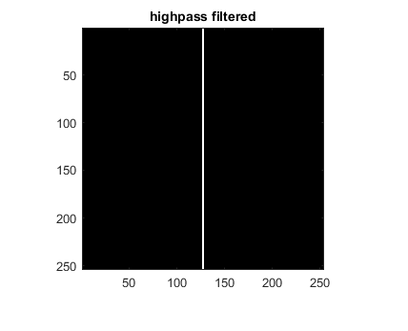

Linear Filter: Edge Detector/HP filter
Edges are represented as a fast/steep changes in the pixel values within a small area
HP filters destroy the low frequency components
Black=0
White=255
Derivative filter
Vertical edge detector
Black Area
Middle area
White area
=0
=255*3
=0
The edge image is the magnitude of the gradient at every pixel

Slide 14


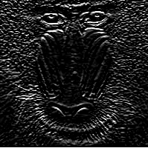

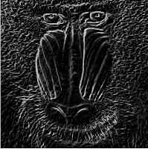

Linear Filter: Edge Detector/HP filter
Edges are represented as a fast/steep changes in the pixel values within a small area
HP filters destroy the low frequency components
Horizontal edge
Sobel detector
Vertical edge
Sobel detector
$$Edges=\sqrt{{Edge}_{x}^{2}+ {Edge}_{y}^{2}}$$
mandrill
horizontal edges
Vertical edges
Complete edges
The edge image is the magnitude of the gradient at every pixel

Slide 15
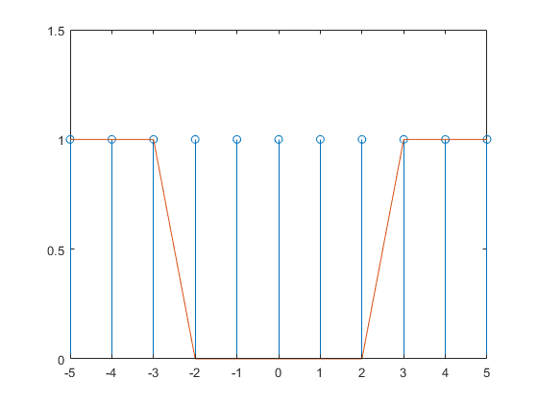
Linear Filter: Edge Detector/HP filter
View from a frequency perspective
High Pass Filter for 1D-signals:
Supress the low
frequency components

Slide 16
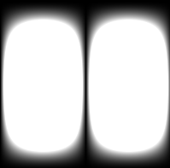
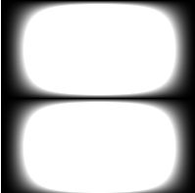
Linear Filter: Edge Detector/HP filter
From the frequency point of view, we are destroying the low frequency components
Sobel
Operators
mandrill
Complete edges
Freq retained
Freq retained
Freq retained
Freq retained
Vertical
Sobel
Horizontal
Sobel

Slide 17
Linear Filters: HP/LP filters applications
LP filters/smoothing images:
Downscale images in a better way
Remove noise
Remove high frequency components before other operations e.g. edge detection
HP filters/edge detectors:
Contour operations
Easier to recognize objects by their contours than directly
Mask in/out objects or regions in the images
Moment operations

Slide 18
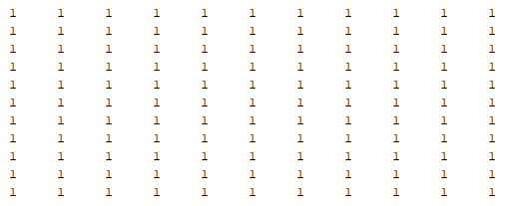
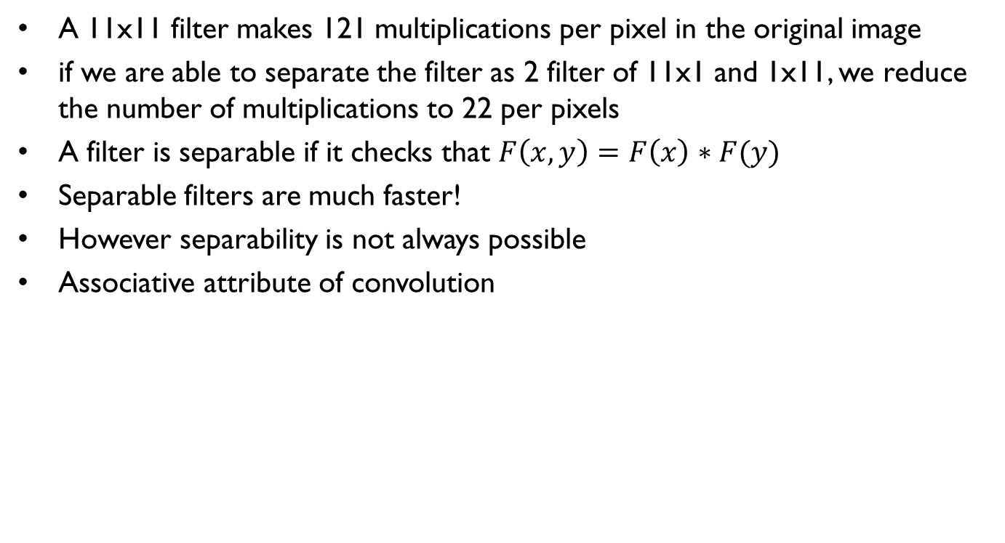
Linear Filter: Separable filters
A 11x11 filter makes 121 multiplications per pixel in the original image
if we are able to separate the filter as 2 filter of 11x1 and 1x11, we reduce the number of multiplications to 22 per pixels
A filter is separable if it checks that $F\left(x,y\right)=F\left(x\right)∗F(y)$
Separable filters are much faster!
However separability is not always possible
Associative attribute of convolution
=
*

Slide 19

Linear Filter: Separable filters
*
=
*
=
*
=

Slide 20
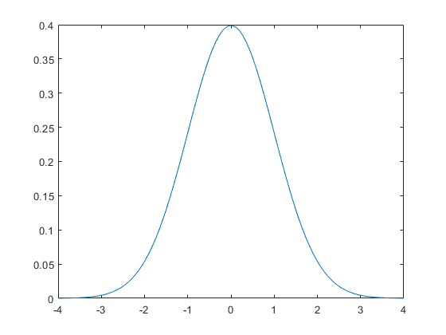
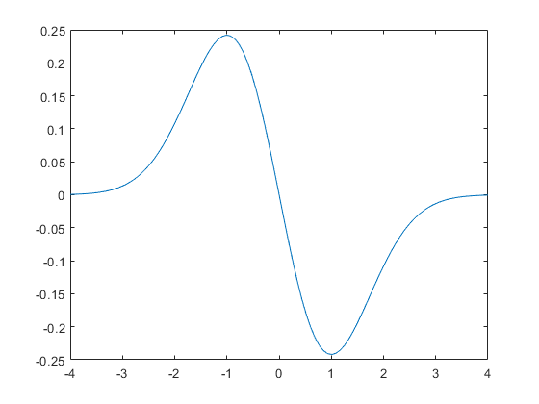

Linear Filter: Gaussian Filters 1D
A gaussian is a function that fits the following equation:
$G\left(x\right)=\frac{1}{\sqrt{2π}σ}e^{−\frac{x^{2}}{2σ^{2}}}$
A first order derivative of gaussian is as follows:
$\frac{dG(x)}{dx}=\frac{−x}{\sqrt{2π}σ^{3}}e^{−\frac{x^{2}}{2σ^{2}}}$
It is by construct a
Low-pass filter!
It is a derivative filter!

Slide 21
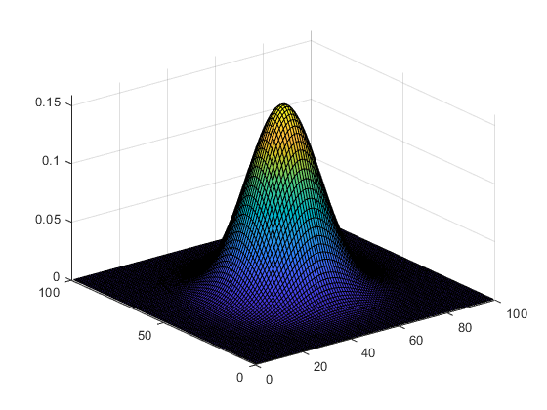
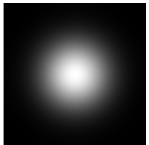
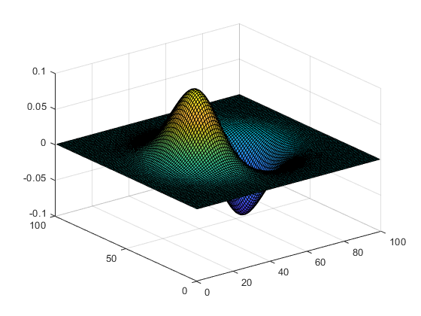
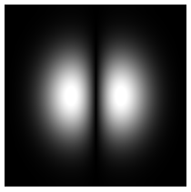

Linear Filter: Gaussian Filters 2D
A gaussian is a function that fits the following equation:
$G\left(x,y\right)=\frac{1}{2πσ^{2}}e^{−\frac{x^{2}+y^{2}}{2σ^{2}}}$
A first order derivative of gaussian is as follows:
$\frac{dG(x,y)}{dx}=\frac{−x}{2πσ^{4}}e^{−\frac{x^{2}+y^{2}}{2σ^{2}}}$
Almost the same in
The frequency domain!

Slide 22
Linear Filter: Gaussian Filters
Gaussian Filters are isotropic!
Treats all angles in the same way
Gaussian Filters are separable!
We can convolve the images with 2 1D gaussian filters, one along each axis
Uniform Average Filter
2D Gaussian Filter

